Slide 1

Power of Chaos: Long-term Security for Post-quantum Era
Rahul Vishwakarma
Graduate Student
California State University, Long Beach
rahuldeo.vishwakarma01@student.csulb.edu
Dr. Amin Rezaei
Assistant Professor
California State University, Long Beach
amin.rezaei@csulb.edu
Dr. Ava Hedayatipour
Assistant Professor
California State University, Long Beach
ava.hedayatipour@csulb.edu

Slide 2
Agenda
Post-quantum era
Chaos cryptography
Conclusion

Slide 3
Post Quantum Era
Risks for classical cryptography

Slide 4



Asymmetric cryptography
Security foundations
Integer factorization
Discrete logarithms
Encryption
Decryption
Message
Cipher Text
Message
Public Key
Secret Key
Figure 1: Asymmetric cryptography
Notes:
Discrete logarithms – one-way functions – time needed to reverse it.

Slide 5
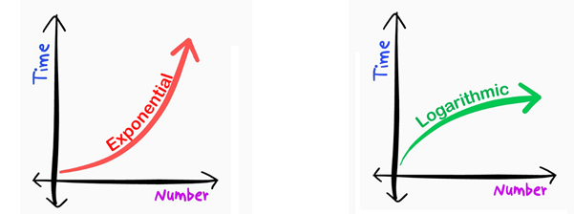
Post-quantum era
Quantum computers
Qubits
Superimposition
Entanglement
Shor’s algorithms
Impact on classical cryptography
RSA scheme
Finite Field Diffie-Hellman key exchange
Elliptic Curve Diffie-Hellman key exchange
Figure 2: Classical Vs Quantum computers to break cryptosystem
Notes:
Quantum computers.
How it works?
qubits – subatomic particles, (extremely low temperature than deep space) – management is extremely complex.
properties – super imposition and entanglement.
- What it promises?
- What all it can do?
- They are good at prime factorization
- what all it can’t do?
- sorting - as it has multiple output,
Existing algorithms – millions of years; Quantum computer – few hours.
Are they threat right now? The answer is NO
- We don’t have any evidence of even experimental quantum computers break classical cryptography.
Shor algorithm – algorithm implemented with 7 qubits.
https://youtu.be/dONacVnW1Ng

Slide 6
Quantum safe algorithms
Lattice
Code
Hash
Non-commutative
Multivariate
Isogeny
Academics and Industry
PyCrypto
European Telecommunications Standards Institute (ETSI)
Institute of Quantum Computing

Slide 7
Where we need quantum safe cryptography?
Medical records
5 – 100 years
Implantable wearable devices
Biomedical devices
Financial institutions
Tax
Communication
Notes:
Medical images – clinical trials US 5 years; Health records Japan 100 Years.
IWD example; comparison to financial loss; life is more important.
Summarize on this slide.

Slide 8
Chaos-Based Cryptography

Slide 9
Chaos
Properties
Deterministic
Mathematical model
Nonlinear
Logistic map
Sensitive dependence
Butterfly effect
Notes:
Dictionary meaning
Confusion, disorder, havoc, noise, madness
https://www.section.io/engineering-education/chaos-cryptography/
Many authors have considered such dynamical properties of
chaos to be effective for building secret-key cryptosystems
in terms of the notions of diffusion and confusion.
Chaos has been applied for secret key cryptography – message encrypted from pseudorandom number generated from a chaotic time series
Symmetric – Chaos control, distributed dynamics encryption, chaotic shift keying, chaotic block cipher,

Slide 10
Chaos – Deterministic
Mathematical model
Discrete equations
Logistic map
Differential equations
Lorenz system
Notes:
It can be expressed as a mathematical model as simple equations.
Discrete equation | Differential equations.
Talk about other chaotic systems.

Slide 11
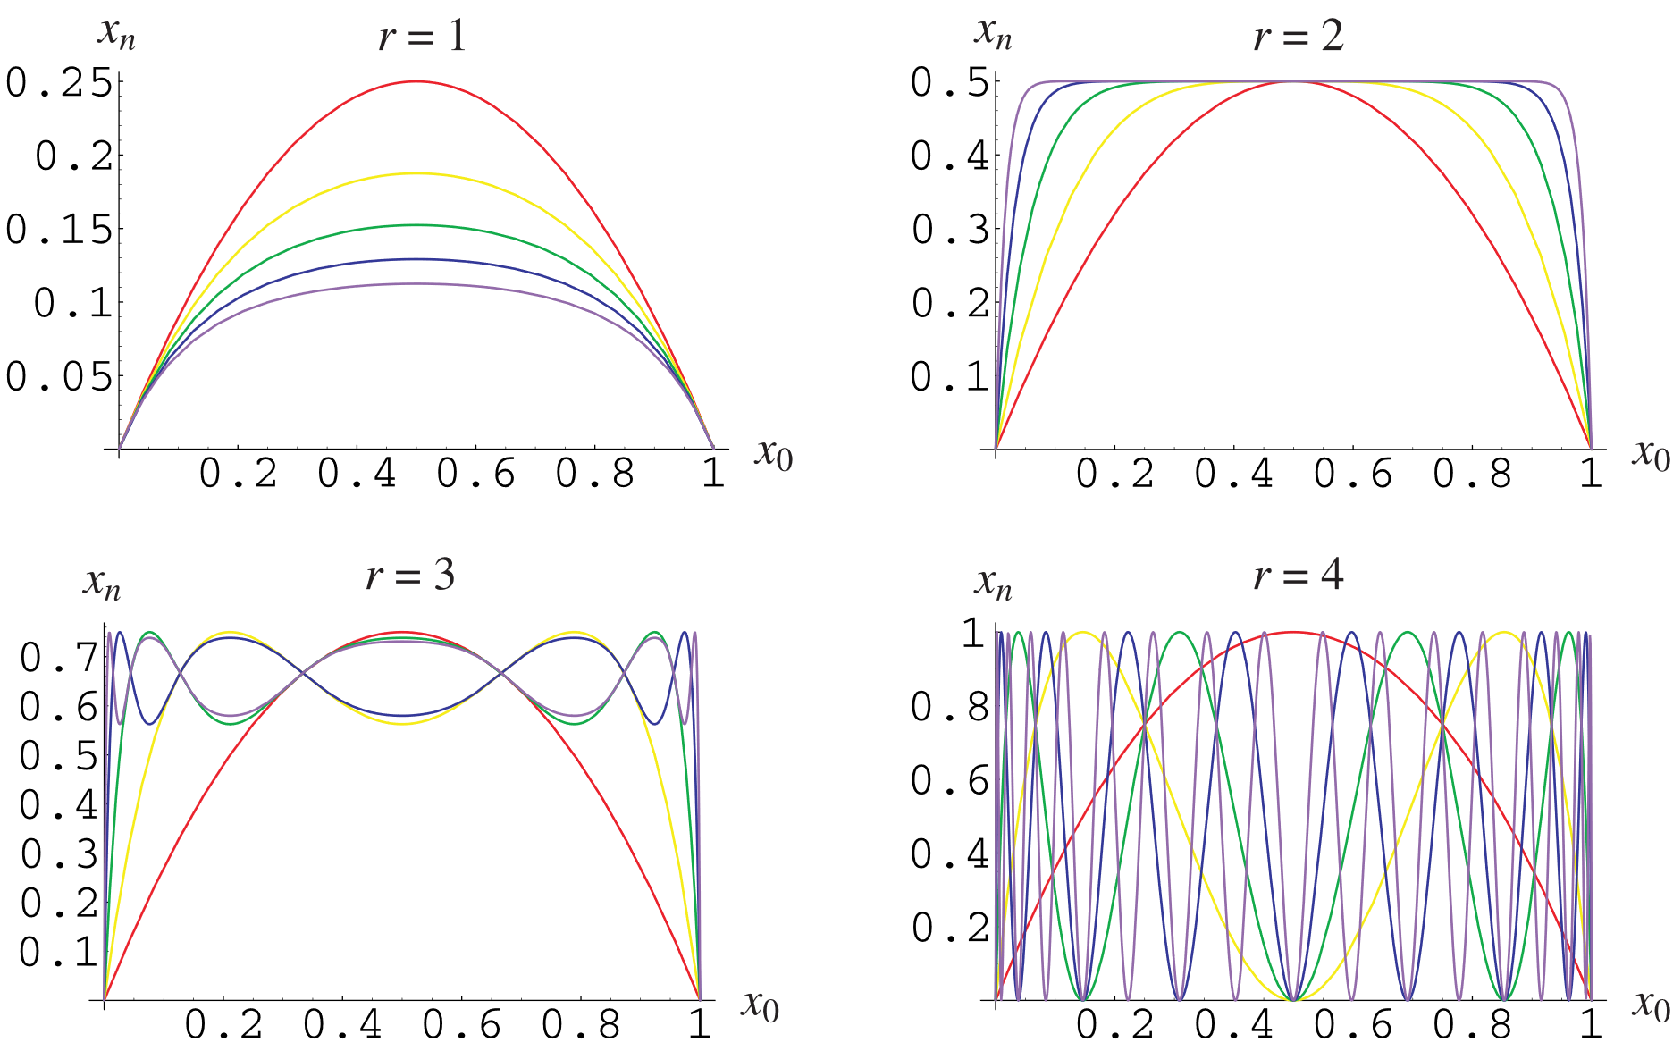

Chaos – Nonlinear
Logistic Map
Figure 3: Plotting logistic map for different values of r
Notes:
Nonlinearity makes it suitable for cryptographic attacks.

Slide 12
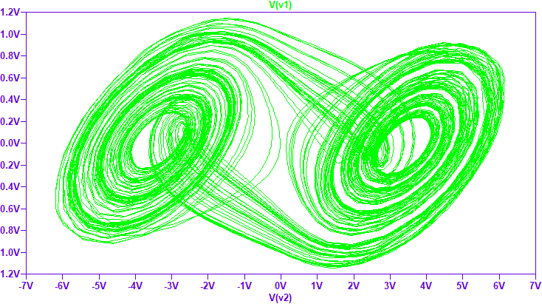
Chaos – Sensitive dependence
Butterfly effect
0.1 | 0.101
0.3465 | 0.34957615
0.871785338 | 0.875384762
0.430336302 | 0.419982181
0.943815831 | 0.937849022
0.204155905 | 0.2244097
10.62553365 | 0.670092448
0.901829019 | 0.851113953
10.34085374 | 0.48786812
10.864989 | 0.961933347
0.449614656 | 0.140977693
0.952726071 | 0.466246485
0.173400554 | 0.958113696
0.551831287 | 0.15450759
0.952157043 | 0.50294473
Figure 4: Double scroll attractor for Chau chaotic equations
Notes:
Initially they look very similar.

Slide 13
Cryptographic algorithms and chaotic system
Cryptographic algorithms | Chaotic Systems
Finite set of integers | (sub)set of real numbers
Algebraic methods | Analytic method
Rounds | Iterations
Key (Boolean) – Discrete keyspace | Parameters (real) – Continuous keyspace
Diffusion | Sensitivity to change in initial condition
Security and performance | ?

Slide 14
Chaotic system architecture
Cipher Text
Plain Text
Data stream encryption
Public
channel
Data stream decryption
Plain Text
Cipher Key
Cipher Key
Chaotic Generator
Chaotic Generator
Synchronization
Figure 5: High level architecture of chaotic cryptography

Slide 15
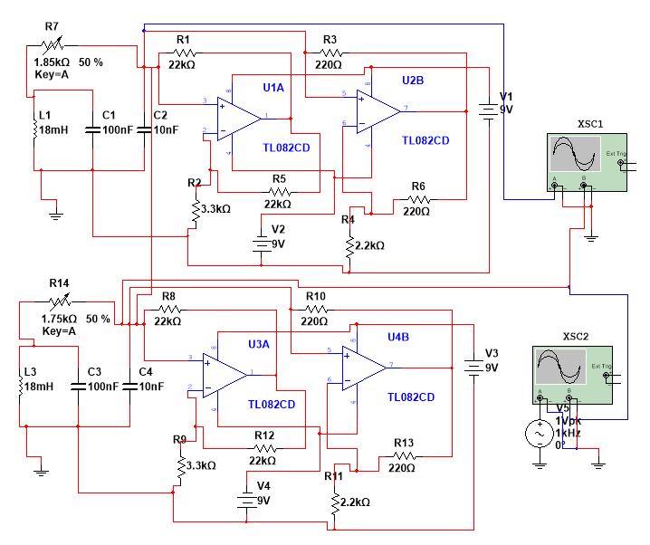
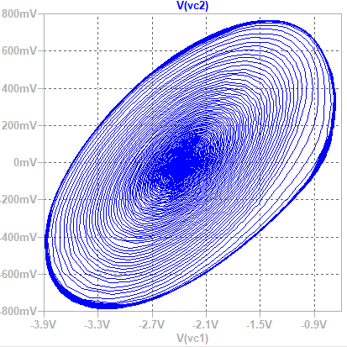
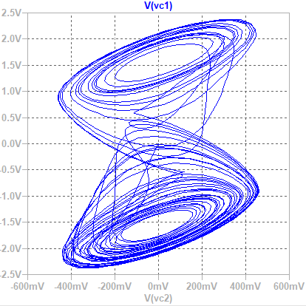
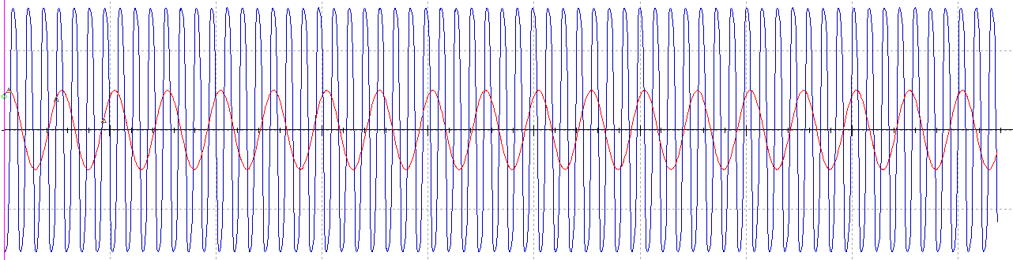
Chua chaotic circuit
Figure 7: Single scroll attractor
Figure 8: Double scroll attractor
Figure 6: Circuit realization of Chau chaotic circuit
Figure 9: Plain text and encrypted information with Chaos

Slide 16
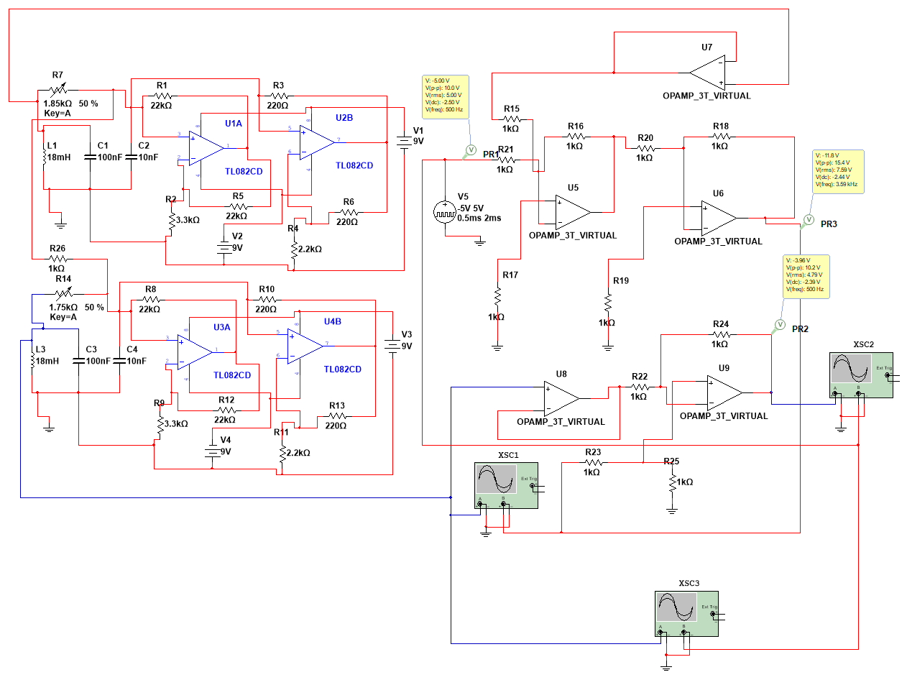
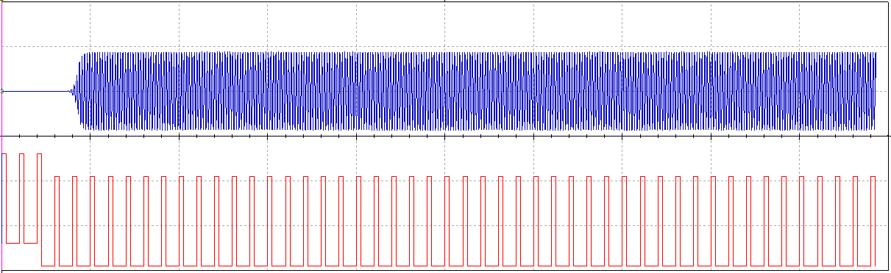
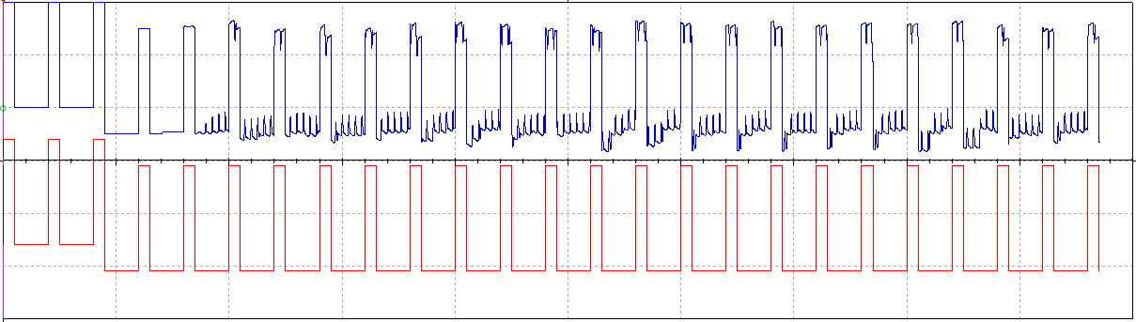
Chua chaotic circuit
Figure 11: Actual message in red and encrypted message in blue
Figure 10: Circuit realization of Chau chaotic circuit with different initial values
Figure 12: Actual message in red and decrypted message in blue

Slide 17
Implementation challenges
Definition of the key leading to non-chaotic behavior
Nonuniform probability distribution function
Return map reconstruction
Low sensitivity to secret key
Erosion of computational efficiency due to the structural complexity
Notes:
Small chaotic regime
Tested only for limited range
Has low key space when these maps are used for generating keys
Susceptible to brute force attack
Round 1 Submission (NIST)
RVB Algorithm - Lenstra–Lenstra–Lovász (LLL) lattice basis reduction algorithm
Chebyshev chaotic map
previous
methods for chaos-based cryptography are not secure in the
sense that secret keys appear to be broken even using a
classical computer because of the weak constitution of the
keys and/or insecure methods for exchanging chaotic signals
between users.

Slide 18
Design rule for chaos-based cryptography
Exhaustive and rigorous definition of key and the keyspace
Selection of chaotic maps with high sensitivity to control parameter mismatch
Analysis of the performance of chaotic orbits as source of entropy
Resistance to application-specific attacks
Resistance to classical attacks

Slide 19
Industrial Adoption

Slide 20
National Institute of Standards and Technology (NIST)
Lattice problems and hash functions
Public-key-encryption (1)
Digital signatures (3)
Post-quantum Cryptography VPN, Microsoft
PICNIC (Digital signature algorithms), Microsoft
Quantum Safe services: Kyber, IBM
AWS KMS API endpoints, AWS KMS
Notes:
https://aws.amazon.com/blogs/security/round-2-post-quantum-tls-is-now-supported-in-aws-kms/#:~:text=AWS%20Key%20Management%20Service%20(AWS,to%20AWS%20KMS%20API%20endpoints.

Slide 21
Conclusion

Slide 22
Conclusion
Understanding chaos-based cryptology
Challenges in implementing post-quantum era cryptography
No silver bullet for quantum safe algorithms
Growing industrial adoption
Chaos-based cryptography (?)

Slide 23
Please take a moment to rate this session.
Your feedback is important to us.

